Slide 1
Open source and proprietary or closed source
What is this ?

Slide 2
Eucalyptus Cloud as IaaS
IaaS Style is private and hybrid clouds.
Infrastructure resources (machines, network and storage )
Implemented inside existing data center
Implement industry standard AWS APIs.
Provide own set of command line tools (Euca2ools):internal and external
The main components are Cluster controller , cloud controller, Node controller, walrus storage controller and storage controller

Slide 3
Eucalyptus Components
Cluster Controller(CC): manage NCs, manage , communicate between controllers, and manage networks specific instances
Cloud Controller (CLC): front end, provide EC2/S3 interface
Node Controller (NC): basic component of node, maintains instance on each nodes, interact with OS, Hypervisor and CC
Walrus Storage (WS3): file storage system, such as machine image, snapshots,
Storage Controller (SC): provide persistent block storage and allows creation of snapshots of volumes.

Slide 4
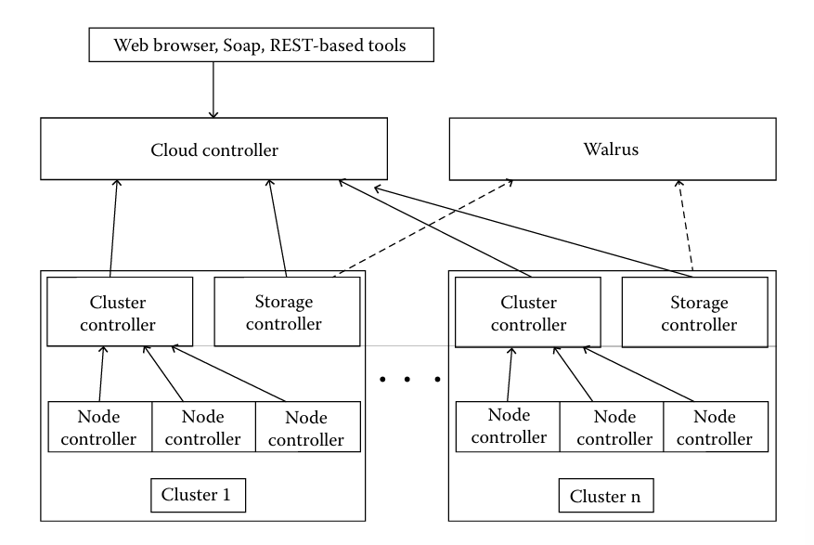

Slide 5
More Open Source Iaas
OpenNebula
Apache CloudStack: good for large networks of vms
Nimbus: good in terms of administration of Virtual networks, as it is supported by SSH into all nodes

Slide 6
OpenSource PaaS
Paasmaker: provide full visibility to users, actions are broken into trees format to be monitored, portable with PHP, Ruby, python, Nodejs, designed for clusters. (distribution and cluster failure )
Red Hat Openshift: broker, node servers.
Broker is single point of contact for all application management activities(login, DNS, application state, orchestration of application.)
Node server has built-in cartridges and gears. Where user application is stored and served

Slide 7
OpenNebula Scheduler Module
An algorithm that places Virtual Machine depending on their requirements.

Slide 8
Open Source Tools for Research
Simulation-based approaches in evaluating cloud computing systems and application behaviors offer significant benefits, as they allow cloud developers
to test performance of their provisioning and service delivery policies in a repeatable and controllable environment free of cost
to tune the performance bottlenecks before real-world deployment on commercial clouds

Slide 9
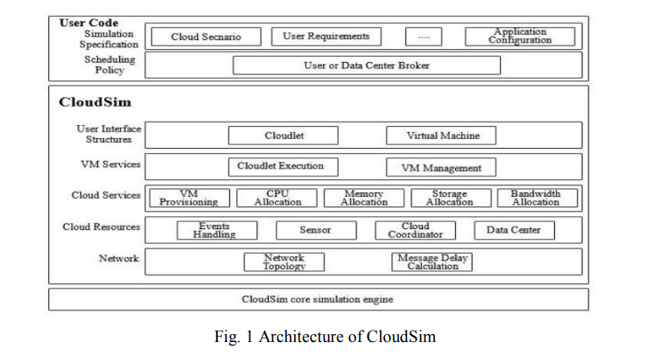
CloudSim
Simulation environment.
Allow extension and definition of policies in all component of software stack.

Slide 10
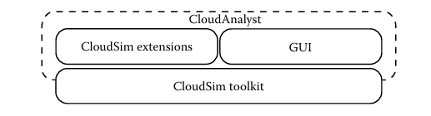
Cloud Analyst
Extension of cloud-sim developed by Melbourne university.
To support evaluation of social network tools according to geographic distribution of user and data centers.

Slide 11
GreenCloud
Packet-level simulator for energy-aware cloud computing data centers.
Offers detailed fine-grained modeling of the energy consumed by the data center IT equipment.
Further can be used for monitoring, resource allocation, workload scheduling , optimization pf communication protocols and network infrastructure
Can guide for future data center facilities

Slide 12
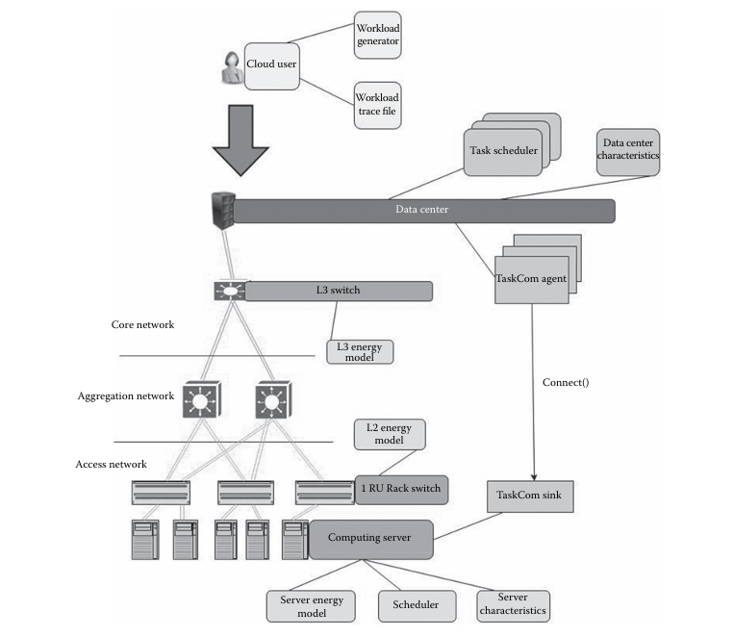

Slide 13
CloudSched and Cloud Report

